Slide 1
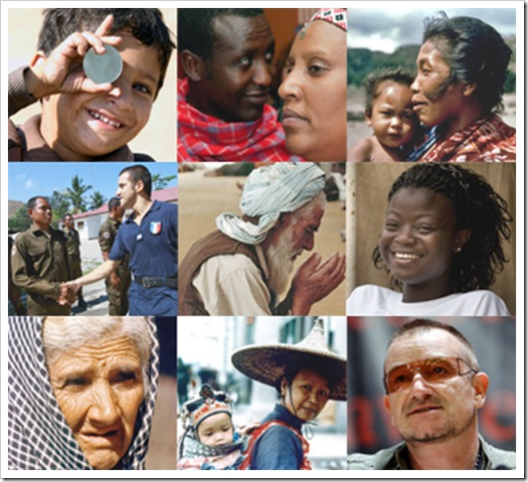
People

Slide 2
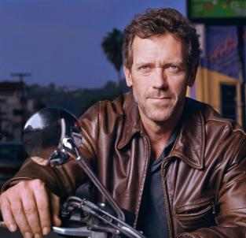
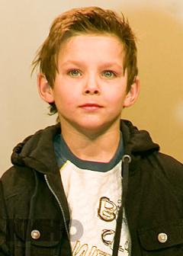
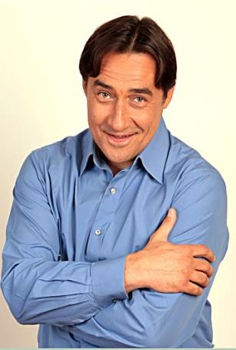
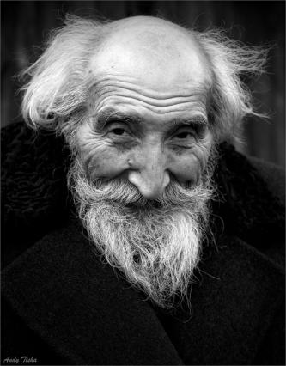
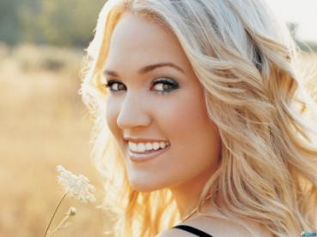
48
Age
42
87
23

Slide 3
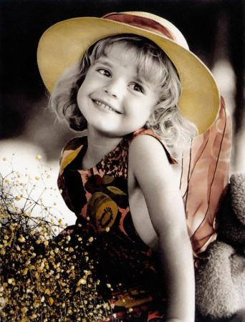
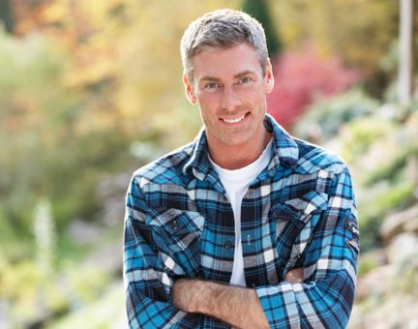
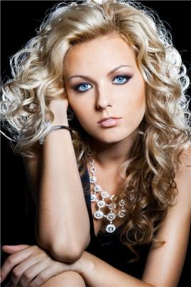
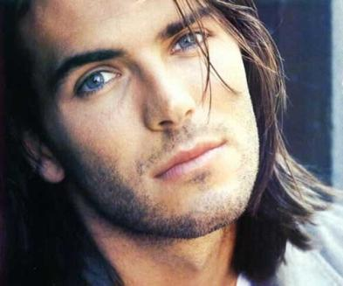
Looks
pretty
Good-looking
beautiful
handsome

Slide 4
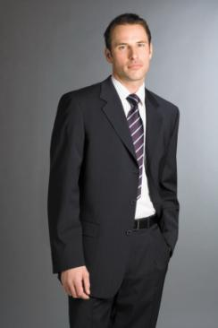
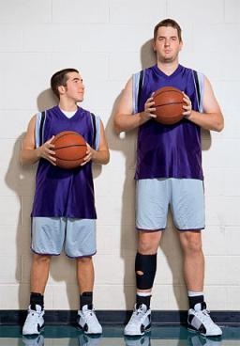
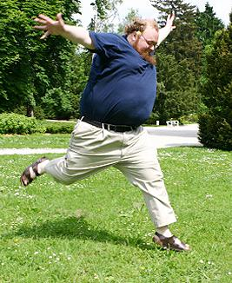
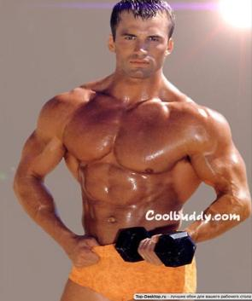
Height and Weight
short
tall
slim
overweight
Well-build

Slide 5
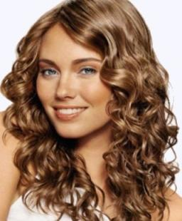
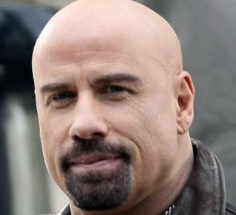
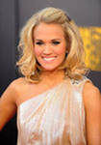
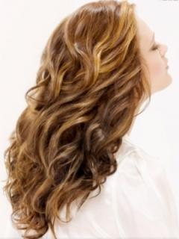
Hair
frizzy
bald
curly
wavy
Beard and moustache
blond

Slide 6
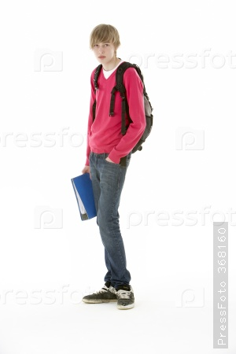
This is a ... .
He’s a ... , he’s ... years old.
He’s ... .
He’s not ..., he’s ... .
He has got ... ... hair.
His face is ... .
He’s ... .
Good-looking, oval, short, fair, plump, slim, tall, teenage, fifteen, boy

Slide 7
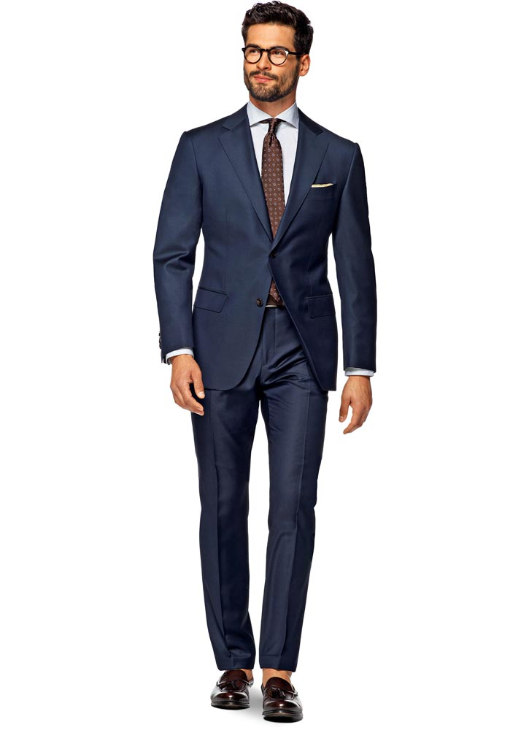
This is a man.
He’s middle-aged, he’s about 34 years old.
He’s tall and well-built.
He has got short dark hair, moustache and short beard.
He has got glasses.
His face is not round, it is oval.
He’s very handsome.

