Slide 1
(1) Teacher (Учитель): Кашкарова Людмила Валерьевнаfinel
The English language
(Английский язык)

Slide 2
(2)At the lesson (На уроке)
The sound of your microphone is off (Звук вашего микрофона выключен)
Turn on the sound of your mic only upon the teacher’s request (Включаем звук микрофона только по просьбе учителя)

Slide 3
(3)Greeting and checking the connection (Приветствие и проверка связи)
Good morning. Glad to meet you. (Доброе утро. Рада встрече с вами)
How are you? (Как вы?)
Is everything OK with your sound and your picture. (Все ли в порядке со звуком и изображением?)
I am fine. Everything is OK.(Все в порядке)
I have some problems. (Есть проблемы.)

Slide 4
(4)Answer our usual questions (Ответьте на наши обычные вопросы)
What is the number of today’s lesson?
What day is it today?
What date is it today?

Slide 5
(5)The final lesson of the second quarter
Friday
The 25th of December

Slide 6
(6)New Year is coming…
Congratulations!!!!

Slide 7
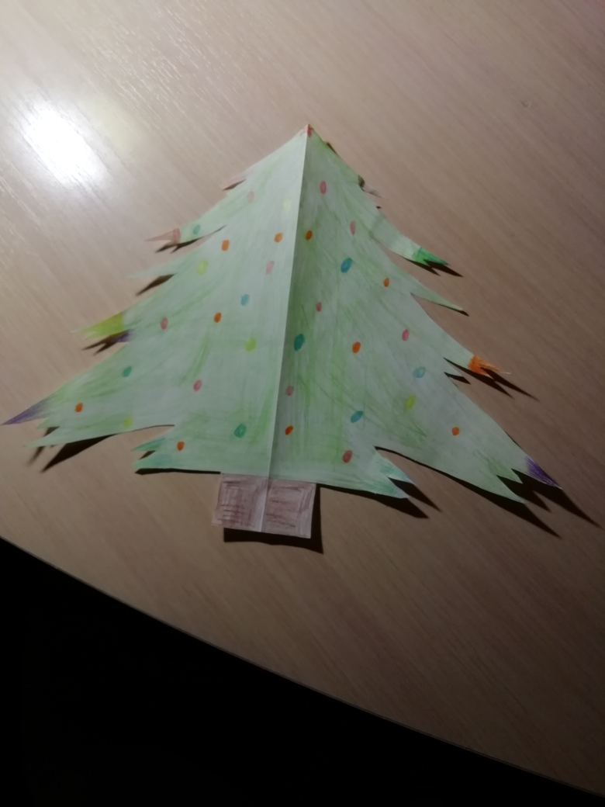
(7)Congratulations!!!! From the first group (*первая группа – 6а класс)

Slide 8
(8)Congratulations!!!! From the second group (*вторая группа – 6б класс)

Slide 9
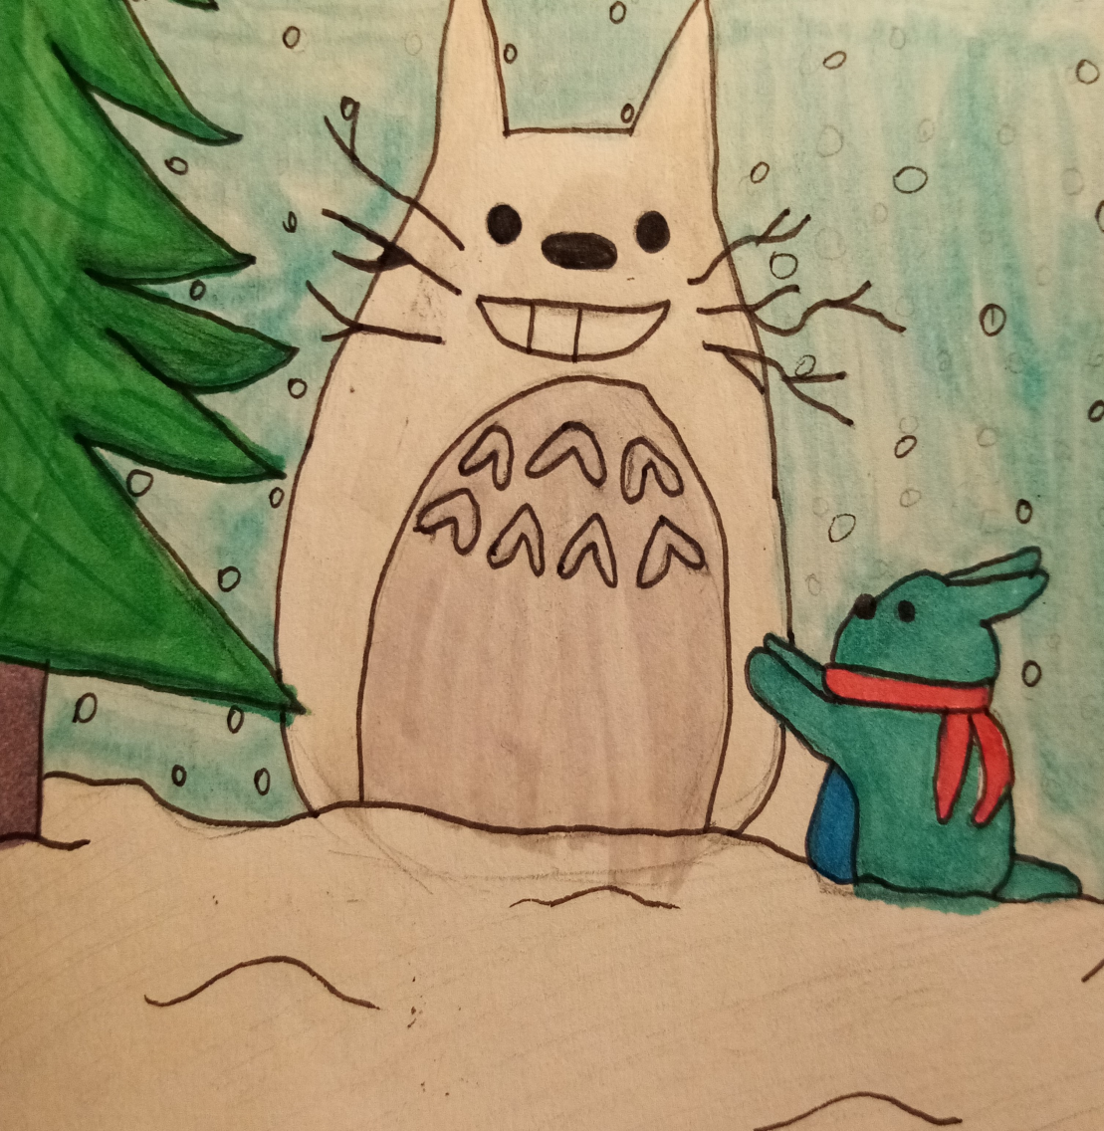
(9)Congratulations!!!! From the second group (*вторая группа – 6б класс)

Slide 10
(10)Congratulations!!!! From the third group (*третья группа – 6в класс)

Slide 11
(11)Congratulations!!!! From the fourth group (*четвертая группа – 6г класс)

Slide 12
(12)Congratulations!!!! From the fifth group (*пятая группа – 6к класс)

Slide 13
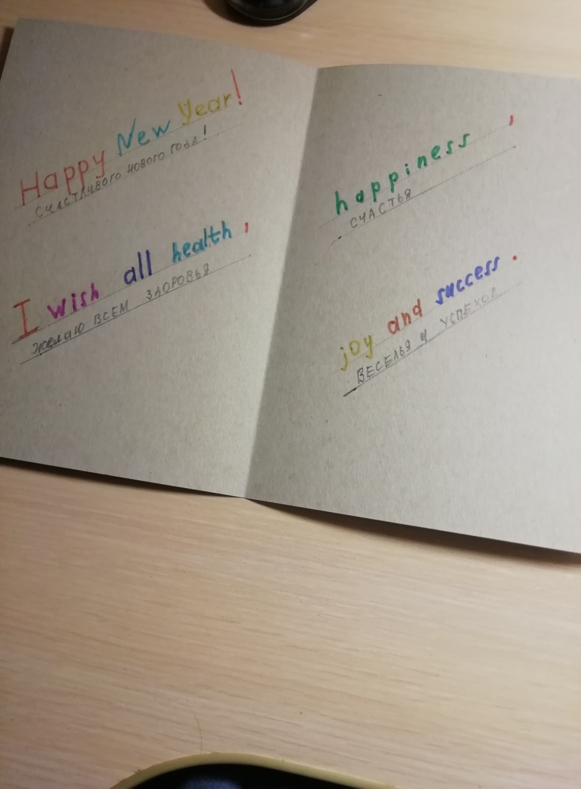
(13)Congratulations!!!! From the fifth group (*пятая группа – 6к класс)

Slide 14
(14)Congratulations!!!! From the fifth group (*пятая группа – 6к класс)

Slide 15
(15)Congratulations!!!! From the fifth group (*пятая группа – 6к класс)

Slide 16
(16)Congratulations!!!! From the fifth group (*пятая группа – 6к класс)

Slide 17
(17)Congratulations!!!! From the sixth group (*шестая группа – 10а база)

Slide 18
(18)Home assignment of the lesson (25/12)
Do 15 most important tasks

Slide 19
(19)1) Have plenty of sleep

Slide 20
(20)2) Eat healthy food

Slide 21
(21)3) Spend at least one hour outdoors

Slide 22
(22)4) Play with friends

Slide 23
(23)5)Help your parents

Slide 24
(24)6) Have fun

Slide 25
(25)7) Wear a mask in public

Slide 26
(26)8) Wash your hands

Slide 27
(27)Note

Slide 28
(28)9) Skate

Slide 29
(29)10) Ski

Slide 30
(30)11) Sing

Slide 31
(31)12)Dance

Slide 32
(32)13)Decorate a fur tree

Slide 33
(33)14)Give presents

Slide 34
(34)15) Celebrate New year

Slide 35
(35)New year resolutions Kids, 13 years old and older
I will try to eat two servings of fruit and two servings of vegetables every day. I will drink sodas only at special times.

Slide 36
(36)New year resolutions Kids, 13 years old and older
I will do my best to take care of my body through fun physical activity and eating the right types and amounts of foods.

Slide 37
(37)New year resolutions Kids, 13 years old and older
When I have some down time for media, I will try to choose educational, high-quality non-violent TV shows and video games that I enjoy. I will spend only one to two hours each day – at the most – on these activities. I promise to respect out household rules for videogames and internet use.

Slide 38
(38)New year resolutions Kids, 13 years old and older
When I feel angry or stressed out, I will take a break and find helpful ways to deal with the stress, such as exercising, reading, writing in a journal or talking about my problem with a parent or friend.

Slide 39
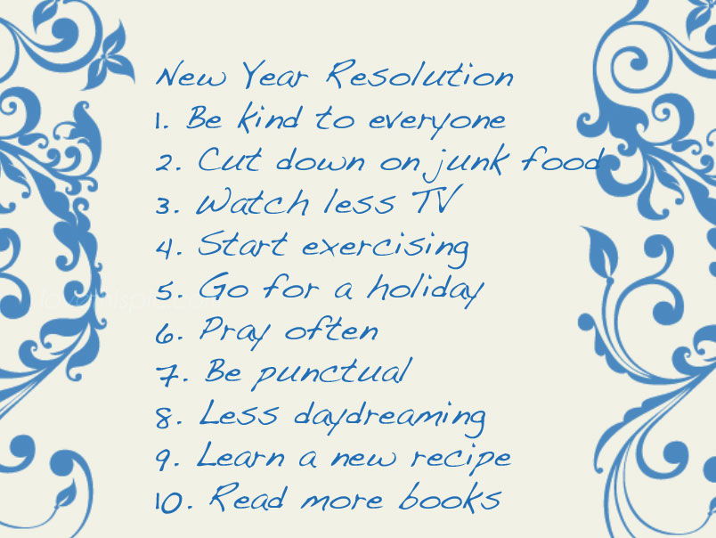
(39)New year resolutions

Slide 40
(40)The lesson is over

