Slide 1
(1) Teacher (Учитель): Кашкарова Людмила
The English language
(Английский язык)
10 form (класс)
Prepare a student’s book, a copybook and a pen.(Подготовьте учебник, тетрадь, ручку)

Slide 2
(2)At the lesson (На уроке)
The sound of your microphone is off (Звук вашего микрофона выключен)
Turn on the sound of your mic only upon the teacher’s request (Включаем звук микрофона только по просьбе учителя)

Slide 3
(3)Greeting and checking the connection (Приветствие и проверка связи)
Good morning. Glad to meet you. (Доброе утро. Рада встрече с вами)
How are you? (Как вы?)
Is everything OK with your sound and your picture. (Все ли в порядке со звуком и изображением?)
I am fine. Everything is OK.(Все в порядке)
I have some problems. (Есть проблемы.)

Slide 4
(4)At the lesson you do class work in your copybooks. (На уроке вы выполняете классную работу в тетрадях)
Write down in your copybook underlined information.(записываете в тетради подчеркнутую информацию)

Slide 5
(5) Marks for the class work (оценки за классную работу )
The mark for the class work is optional - send the photo of the class work to the teacher by mail. (оценка за классную работу по желанию, отправляем фото работы на почту учителя).
“5” – no mistakes (нет ошибок)
“4” – few mistakes (мало ошибок)
“3” – many mistakes (много ошибок)

Slide 6
(6)Answer our usual questions (Ответьте на наши обычные вопросы)
What is the number of today’s lesson?
What day is it today?
What date is it today?

Slide 7
(7)Open your copybooks and write down. (Откройте тетради и запишите)
Classwork
Lesson 45
Thursday
The 24nd of December

Slide 8
(8)Home assignment of the lesson 45 (24/12)
ВНИМАНИЕ!! В журнале - четыре оценки за первые четыре недели карантина и
задание урока 40 засчитывается как контрольное – оценка в журнал.
Кто что-то не сделал – выполняем и отправляем на почту (оценки можно исправить в течении недели)!

Slide 9
(8)Home assignment of the lesson 45 (24/12)
Home assignment is optional. (Домашнее задание по желанию)
Draw a pictogram about Ney Year celebration and winter holidays and sent to the traecer by mail (Рисуем пиктограмму – Новый год и зимние каникулы и отправляем учителю на почту)

Slide 10
(11) Произношение буквосочетания CH
[tʃ] Нет, это не русский «ч», это «тш».
ch — chop
Также звук [tʃ] дают буквосочетания
tion — question
tur — culture

Slide 11
(12)[tʃ] Нет, это не русский «ч», это «тш»
Speak with an English accent, changing the letter «ч» into the letters «тш» (скажите с английским акцентом заменяя букву «ч» на буквы «тш»)
Черный чемодан
Четыре человека
Очень чистый

Slide 12
Произношение буквосочетания CH
Обычно эти две буквы передают один звук, который многими читается, как русский звук Ч.
Но правильнее произносить «тш». В английской транскрипции этот звук выглядит как [ʧ]. Он может стоять в начале, в середине, в конце слова.
chest [ʧest] – сундук
chess [ʧes] – шахматы
chin [ʧɪn] – подбородок
watch [wɔʧ] – смотреть

Slide 13
Произношение буквосочетания CH
Есть слова, в которых комбинация ch читается, как звук К [k]. Это явление
встречается в терминах, которые имеют происхождение из греческого языка.
ache [eɪk] – боль anarchy ['ænəkɪ] – анархия character ['kærəktə] – характер chemical ['kemɪk(ə)l] – химикат chemistry ['kemɪstrɪ] – химия chemist ['kemɪst] – химик choir ['kwaɪə] – хор Christ [kraɪst] – Христос Christmas ['krɪsməs] – Рождество

Slide 14
Произношение буквосочетания CH
Но в словах, пришедших в английский из французского, сочетание ch читается, как Ш (в транскрипции [ʃ]):
champagne [ʃæm'peɪn] – шампанское chaperone ['ʃæp(ə)rəun] – компаньонка charade [ʃə'rɑːd] – шарада chauffeur ['ʃəufə] – шофер chef [ʃef] – шеф-повар machine [mə'ʃiːn] – машина, механизм moustache [mə'stɑːʃ] – усы

Slide 15
Произношение буквосочетания CH
Кроме того, в британском варианте английского языка есть четыре слова, в которых ch в конце слова читается [ʤ](дж):
sandwich ['sænwɪʤ] – сендвич spinach ['spɪnɪʤ] – шпинат Greenwich ['grɪnɪʤ] – Гринвич Norwich ['nɔrɪʤ] – Норидж

Slide 16
Произношение буквосочетания CH
И последнее исключение – слово голландского происхождения yacht (яхта), которое звучит как [jɔt], где сочетание ch вообще не произносится.

Slide 17
(13)Open your student’s books, page 40
Read the text “Skin” after the teacher

Slide 18
Page 40, Read the text “Skin” after the teacher
During the Renaissance in Europe it was unfashionable to have a dark complexion because it was a sign that you worked outside.

Slide 19
Page 40, Read the text “Skin” yourself
During the Renaissance in Europe it was unfashionable to have a dark complexion because it was a sign that you worked outside

Slide 20
Page 40, translate the text “Skin”
During the Renaissance in Europe it was unfashionable to have a dark complexion because it was a sign that you worked outside

Slide 21
Page 40, Read the text “Skin” after the teacher
Because of this men and women did everything they could to keep their skin pale –often women used dangerous chemicals to paint their faces, which sometimes resulted in a painful death.

Slide 22
Page 40, Read the text “Skin” yourself
Because of this men and women did everything they could to keep their skin pale –often women used dangerous chemicals to paint their faces, which sometimes resulted in a painful death.

Slide 23
Page 40, translate the text “Skin”
Because of this men and women did everything they could to keep their skin pale –often women used dangerous chemicals to paint their faces, which sometimes resulted in a painful death.

Slide 24
Page 40, Read the text “Skin” after the teacher
This didn’t change until the 1920s when Coco Chanel, a famous fashion designer, accidentally fell asleep in the sun.

Slide 25
Page 40, Read the text “Skin” yourself
This didn’t change until the 1920s when Coco Chanel, a famous fashion designer, accidentally fell asleep in the sun.

Slide 26
Page 40, translate the text “Skin”
This didn’t change until the 1920s when Coco Chanel, a famous fashion designer, accidentally fell asleep in the sun.

Slide 27
Page 40, Read the text “Skin” after the teacher
The suntan was born and remained popular for the rest of the twentieth century – an easy way to show that you were rich enough to spend your holidays in exotic , sunny places.

Slide 28
Page 40, Read the text “Skin” yourself
The suntan was born and remained popular for the rest of the twentieth century – an easy way to show that you were rich enough to spend your holidays in exotic , sunny places.

Slide 29
Page 40, translate the text “Skin”
The suntan was born and remained popular for the rest of the twentieth century – an easy way to show that you were rich enough to spend your holidays in exotic , sunny places.

Slide 30
Page 40, translate the text “Skin”
The suntan was born and remained popular for the rest of the twentieth century – an easy way to show that you were rich enough to spend your holidays in exotic , sunny places.

Slide 31
Back translation
Сейчас модно иметь темный цвет кожи.
*During the Renaissance in Europe it was unfashionable to have a dark complexion because it was a sign that you worked outside.
** was, were- в прошлом
Am/is/are – в настоящем
*** now – cейчас

Slide 32
Back translation
2)Женщины и мужчины не хотят иметь бледную кожу.
*Because of this men and women did everything they could to keep their skin pale –often women used dangerous chemicals to paint their faces, which sometimes resulted in a painful death.
** do not -отрицание в настоящем времени
*** want – (хотят)
**** to have (иметь)

Slide 33
Back translation
3) Солнечный загар показывает, что ты богат и проводишь свои каникулы в экзотических солнечных местах.
*The suntan was born and remained popular for the rest of the twentieth century – an easy way to show that you were rich enough to spend your holidays in exotic , sunny places.
**В настоящем простом времени:
он/она,оно + глаголs
***was, were- в прошлом
Am/is/are – в настоящем

Slide 34
Back translation
4) Опасно спать на солнце
*Because of this men and women did everything they could to keep their skin pale –often women used dangerous chemicals to paint their faces, which sometimes resulted in a painful death. This didn’t change until the 1920s when Coco Chanel, a famous fashion designer, accidentally fell asleep in the sun.
*it is - подлежащее и сказуемое в безличных предложениях
** to – ставится перед глаголом, который отвечает на вопрос «что делать?»

Slide 35
Back translation
5) Женщины красят свои лица.
*Because of this men and women did everything they could to keep their skin pale –often women used dangerous chemicals to paint their faces, which sometimes resulted in a painful death.

Slide 36
Back translation
6) Женщина красит свое лицо.
*Because of this men and women did everything they could to keep their skin pale –often women used dangerous chemicals to paint their faces, which sometimes resulted in a painful death.
** woman/women
*** she – her
****В настоящем простом времени:
он/она,оно + глаголs

Slide 37
7) Цвет её лица бледный
*During the Renaissance in Europe it was unfashionable to have a dark complexion because it was a sign that you worked outside. Because of this men and women did everything they could to keep their skin pale –often women used dangerous chemicals to paint their faces, which sometimes resulted in a painful death.
** she – her
*** am/is/are - если нет глагола используется глагол-связка

Slide 38
Complete
1)She is pale because…

Slide 39
Complete
2) It is unfashionable to have…

Slide 40
Complete
3) An easy way to show that you are rich is to…

Slide 41
Complete
4) It is painful….

Slide 42
Complete
5) It is dangerous…

Slide 43
Complete
6) A dark complexion is a sign that you...

Slide 44
Complete
7) Exotic , sunny places are…

Slide 45
Page 42 Picture
What can you see?
Where is she?
What is she doing?
Describe the way she looks.
What else can you say about this woman?

Slide 46
Page 44 Picture
What can you see?
Where are they?
What are they doing?
Describe the way they look.
What else can you say about these women?

Slide 47
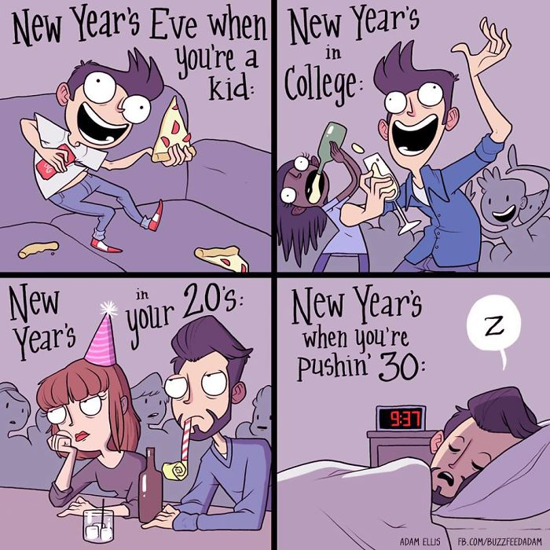
(23)The lesson is over.

